Slide 1
Lesson 10
SQL - Part 4
Variables
Sequence Control
Stored Procedures
Triggers

Slide 2
Variables
Variables can be either:
  LOCAL
  defined with the DECLARE statement
  GLOBAL
  defined and maintained by SQL Server
Lesson 10

Slide 3
Local Variables
Names are preceded by the @ sign
Cannot be defined as text or image
Values are assigned with the SET statement or the SELECT statement
Often used in a batch or stored procedure
Lesson 10

Slide 4
Example
Create a variable, place a string value into the variable, and display it.
DECLARE @testvar char(20)
SET @testvar = 'Comp 1630'
SELECT @testvar
Results
--------------------
Comp 1630
Lesson 10

Slide 5
Example
Create a local variable and use it in a SELECT statement to find the authors who live in the state equal to the local variable
DECLARE @state char(2)
SET @state = 'CA'
SELECT au_fname + ' ' + au_lname AS name
FROM authors
WHERE state = @state
Lesson 10

Slide 6
Example
Use a query to assign a value to a variable
DECLARE @rows int
SET @rows =
( SELECT COUNT ( au_id )
FROM authors )
SELECT @rows
Results
-----------
23
Lesson 10

Slide 7
Example
Use a SELECT statement to assign values to one or more variables
A variable is assigned the value 'Comp 1630'. The query is run against the publishers table with no rows returned because 1877 does not exist. Note that the variable retains the original value.
DECLARE @variable char(20)
SET @variable = 'Comp 1630'
SELECT @variable = pub_name
FROM publishers
WHERE pub_id = '1877'
SELECT @variable
Results
pub_name
--------------------
Comp 1630
Lesson 10

Slide 8
Example
A variable is assigned the value 'Comp 1630'.
The value 1877 requested for pub_id does not exists in the publishers table. The sub-query returns no value, therefore, the variable is set to NULL.
DECLARE @variable char(20)
SET @variable = 'Comp 1630'
SELECT @variable =
( SELECT pub_name
FROM publishers
WHERE pub_id = '1877' )
SELECT @variable
Results
pub_name
--------------------
NULL
Lesson 10

Slide 9
Global Variables
Predefined global variables can be used without being declared
Two @@ signs precede their names
Many global variables report on the system activity since the last time SQL Server was started, or report information about a connection
Lesson 10

Slide 10
Example
@@ ROWCOUNT returns the number
of rows the last SQL statement returned
SELECT pub_name
FROM publishers
WHERE pub_id = '1877'
IF @@ROWCOUNT > 0
PRINT 'FOUND RECORDS'
ELSE
PRINT 'FOUND NO RECORDS '
Results
pub_name
----------------------------------------
FOUND NO RECORDS
Lesson 10

Slide 11
Control-of-Flow
Control-of-flow language controls the flow of execution of SQL statements
Keywords can be used in ad hoc SQL statements, in batches and in stored procedures
Lesson 10

Slide 12
Control-of-Flow
Keyword Description
BEGIN... END | Defines a statement block
CASE expression | Allows an expression to have conditional return values
DECLARE Statement | Declares local variables
IF... ELSE | Conditional, and optionally, alternate execution when FALSE
PRINT Statement | Displays a user-defined message on the screen
Comments | -- for line comment /* together with */ for comment block
GOTO label | Continues processing at the statement following the label
RAISERROR Statement | Returns a system message entry or a dynamically built message
RETURN | Exits unconditionally
WAITFOR | Sets a delay for statement execution
WHILE | Repeats statements while a specific condition is TRUE
... BREAK | Exits the innermost WHILE loop
... CONTINUE | Restarts a WHILE loop
Lesson 10
Notes:
ONLY responsible for knowing the keywords in yellow
FFW

Slide 13
Example
IF ( SELECT AVG (price) FROM titles ) < 15
BEGIN
UPDATE titles
SET price = price * 2
END
ELSE
BEGIN
PRINT 'ERROR'
PRINT ‘No update performed'
END
Lesson 10

Slide 14
Stored Procedures
Saved collection of SQL statements that can take and return user-supplied parameters
Procedures can be created for permanent or temporary use within a session
Stored procedures can be scheduled to run at a specified day and time
Lesson 10

Slide 15
Stored Procedures
Can be:
  SIMPLE
    One SELECT statement
  COMPLEX
    Multiple SELECT statements using control-of-flow statements
Lesson 10

Slide 16
Stored Procedures
Benefits:
  Speed
    Reduces network traffic and increases performance
  Share application logic
    Stored procedures can be incorporated with other stored procedures
  Security
    Give EXECUTE rights only with no table access
Lesson 10

Slide 17
Stored Procedures
Create using the CREATE PROCEDURE statement
CREATE PROCEDURE statements cannot be combined with other SQL statements in a single batch
Objects referenced must exist when executing the procedure
Lesson 10

Slide 18
Stored Procedures
Specify any input and output parameters to the calling procedure before the AS phrase
Specify the programming statements that perform operations in the database, including calling other stored procedures
When executed for the first time, the procedure is compiled to determine an optimal access plan to retrieve the data
Lesson 10

Slide 19
Stored Procedures
Must define:
  Name of the stored procedure
  Names and data types of its parameters
  Names and data types of any local variables used by the procedure
  Sequence of statements executed when the procedure is called
Lesson 10

Slide 20
Stored Procedures
To call a stored procedure:
EXECUTE procedure_name [( parameters )]
To drop a procedure when no longer needed:
DROP PROCEDURE procedure_name
Lesson 10

Slide 21
Example
CREATE PROCEDURE sp_DisplayName
( @parameter varchar(30) )
AS
SELECT @parameter
GO
To run stored procedure:
EXEC sp_DisplayName 'Comp 1630'
Lesson 10

Slide 22
Example
CREATE PROCEDURE sp_Emp_Info
( @parameter1 varchar(30),
@parameter2 varchar(20) )
AS
SELECT emp_id, fname, lname, job_id, hire_date
FROM employee
WHERE lname = @parameter1
AND fname = @parameter2
GO
To run stored procedure:
EXEC sp_Emp_Info 'Devon', 'Ann'
EXEC sp_Emp_Info @parameter2 = 'Ann', @parameter1 = 'Devon'
Lesson 10

Slide 23
Example
CREATE PROCEDURE sp_USA_Publishers
AS
DECLARE @count int
DECLARE @message varchar(50)
SELECT @count = COUNT( pub_id )
FROM publishers
WHERE country = 'USA'
IF @count > 0
SET @ message = CONVERT ( CHAR(2), @count ) + ' publishers in the USA'
ELSE
SET @ message = 'No publishers in the USA'
SELECT @ message
GO
To run stored procedure:
EXEC sp_USA_Publishers
Results
6 publishers in the USA
Lesson 10

Slide 24
Example
CREATE PROCEDURE sp_Average
( @parameter1 smallint,
@parameter2 smallint,
@parameter3 smallint,
@parameter4 smallint OUTPUT )
AS
SELECT @parameter4 = ((@parameter1 + @parameter2 + @parameter3) / 3)
GO
To run stored procedure:
DECLARE @Average smallint -- to contain result
EXECUTE sp_average 5, 3, 7,
@Average OUTPUT
SELECT 'The average is ', @Average
Results
-------------------------- ------
The average is 5
Lesson 10
Notes:
FFW

Slide 25
Example
CREATE PROCEDURE sp_Author_Info
( @parameter1 varchar (30) = NULL,
@parameter2 varchar (20) = NULL )
AS
BEGIN
IF @parameter1 IS NULL AND @parameter2 IS NULL
PRINT 'Please provide name.'
ELSE
SELECT a.au_lname, a.au_fname, t.title, p.pub_name
FROM authors a
INNER JOIN titleauthor ta ON a.au_id = ta.au_id
INNER JOIN titles t ON t.title_id = ta.title_id
INNER JOIN publishers p ON t.pub_id = p.pub_id
WHERE a.au_lname LIKE @parameter1
AND a.au_fname LIKE @parameter2
END
GO
Lesson 10

Slide 26
Example
EXEC sp_Author_Info Hunter, Sheryl
au_lname au_fname title pub_name
---------------------- ------------- -------------------------------- --------------
Hunter Sheryl Secrets of Silicon Valley Algodata Infosystems
(1 row(s) affected)
Lesson 10

Slide 27
Triggers
Special type of stored procedure bound to a specific table
fires when a DML operation is attempted (such as an INSERT, UPDATE, or DELETE)
Often created to enforce referential integrity or consistency among logically related data in different tables
Any errors in the transaction or in the trigger will roll back the entire transaction
Can check data before and/or after a transaction has been made
Fires once per statement; not once per row
Lesson 10

Slide 28
Trigger Types
  AFTER Trigger
    Fires after a the DML operation is carried out
    Most common type of trigger
    Used with INSERT, DELETE or UPDATE statements
    Requires ROLLBACK when error occurs
  INSTEAD OF Trigger
    Fires instead of a DML operation
    Executes something other than the triggering action
    Used with INSERT, DELETE or UPDATE statements
    Does not require ROLLBACK when an error occurs but must execute DML operation if no error is detected
  Order of execution
    INSTEAD OF trigger
    Regular constraints
    AFTER trigger
Lesson 10

Slide 29
Trigger Benefits
Capable of enforcing complex restrictions
Used to track or log changes to a table
More than one AFTER trigger can be created on a table
Only one INSTEAD OF trigger of each type can be created on a table
Can execute stored procedures
Lesson 10
Notes:
ONE INSTEAD OF trigger for each of update, delete, and Insert
FFW

Slide 30
Triggers
Have access to two special virtual tables called inserted and deleted which are pre-defined for each table
Structure of both inserted and deleted virtual tables is identical to target table
Virtual tables are based on the contents of the transaction log and reference the values affected by the INSERT, UPDATE or DELETE statements performed against the target table to which the trigger is attached
Lesson 10

Slide 31
Triggers
Inserted Virtual Table
  Contains copies of the new row when an INSERT statement is executed or the updated row when an UPDATE statement is executed
Deleted Virtual Table
  Contains the deleted row when a DELETE statement is executed, or the old values when an UPDATE statement is executed
Lesson 10

Slide 32
INSERT Triggers
Used to ensure that the data being inserted into a target table is valid
When an INSERT transaction is detected by the database, the insert trigger is fired
When the trigger runs, the inserted data is inserted into both the target table and the inserted virtual table
Copy of the new row stays in the inserted virtual table until the trigger decides how to implement the data insert
Lesson 10

Slide 33
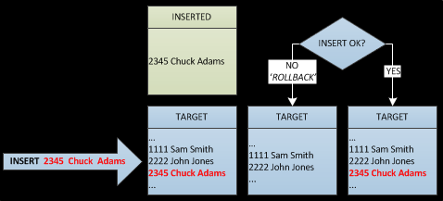
INSERT Trigger Schematic
Lesson 10

Slide 34
INSERT Example
CREATE TRIGGER tr_SalesCheck
ON sales
FOR INSERT
AS
IF ( SELECT qty FROM inserted ) > 50
BEGIN
PRINT 'Quantity cannot exceed 50'
ROLLBACK TRANSACTION
END
Lesson 10

Slide 35
INSERT Example
INSERT INTO sales
VALUES
( '6380',
'6873',
'Sep 15 1994',
60,
'Net 60',
'BU1032' )
Results
Quantity cannot exceed 50
Lesson 10

Slide 36
UPDATE Triggers
Can occur at both the table level and the column level
Original data is moved to the deleted virtual table
New updated rows are then moved to both the target table and the inserted virtual table
Once the data has been successfully moved, the trigger will check to see if the data can be verified
Lesson 10

Slide 37
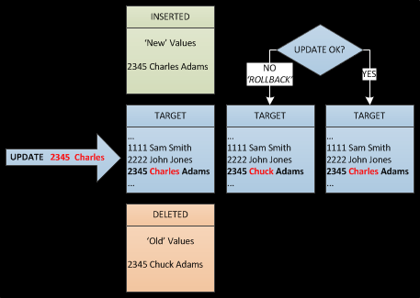
UPDATE Trigger Schematic
Lesson 10

Slide 38
UPDATE Example – Table Level
Fires when any column in the row is updated
CREATE TRIGGER tr_NoHighQty
ON sales
FOR UPDATE
AS
IF ( SELECT qty FROM inserted ) > 50
BEGIN
PRINT 'Quantity cannot exceed 50' ROLLBACK TRANSACTION
END
Lesson 10

Slide 39
UPDATE Example
UPDATE sales
SET qty = 60
WHERE stor_id = '6380'
AND ord_num = '6871'
Results
Quantity cannot exceed 50
Lesson 10

Slide 40
UPDATE Example – Column Level
Uses the IF UPDATE (column_name) clause which binds the update trigger to a column
Executes when data in a particular column is altered
CREATE TRIGGER tr_NoHireDate
ON employee
FOR UPDATE
AS
IF UPDATE (hire_date)
BEGIN
PRINT 'The hire date cannot be changed'
ROLLBACK TRANSACTION
END
Lesson 10

Slide 41
UPDATE Example
UPDATE employee
SET hire_date = 'Jan 10 1990'
WHERE emp_id = 'PMA42628M'
Results
The hire date cannot be changed
Lesson 10

Slide 42
DELETE Triggers
Executed when a DELETE statement is issued against rows in a table
Can prevent deletion of crucial data
Deleted rows are moved from the target table to the deleted virtual table
Lesson 10

Slide 43
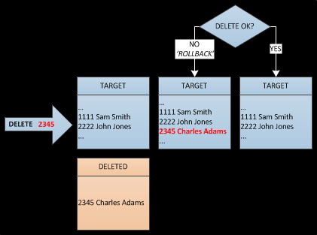
DELETE Trigger Schematic
Lesson 10

Slide 44
DELETE Example
CREATE TRIGGER tr_NoDeleteQty
ON sales
FOR DELETE
AS
IF ( SELECT qty FROM deleted ) > 0
BEGIN
PRINT 'Cannot delete non-zero item'
ROLLBACK TRANSACTION
END
Lesson 10
Notes:
FFW

Slide 45
DELETE Example
DELETE FROM sales
WHERE stor_id = '6380'
AND ord_num = '6871'
Results
Cannot delete non-zero item
Lesson 10

Slide 46
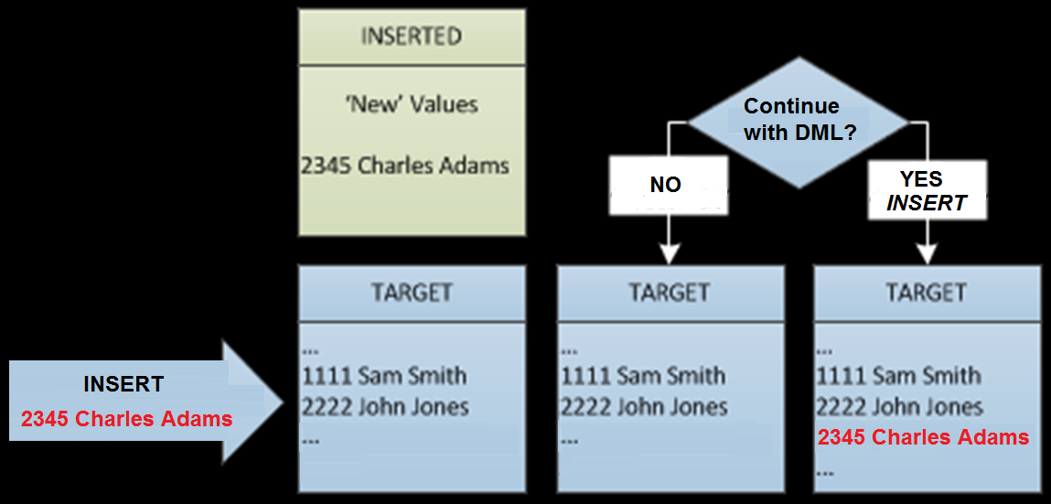
INSTEAD OF Trigger Schematic
Lesson 10

Slide 47
INSTEAD OF Example
CREATE TRIGGER tr_SalesCheck
ON sales
INSTEAD OF INSERT, UPDATE
AS
IF ( SELECT qty FROM inserted ) > 50
BEGIN
PRINT 'Quantity cannot exceed 50'
END
ELSE
BEGIN
INSERT INTO sales
SELECT *
FROM inserted
END
Lesson 10
Notes:
Need to use inserted table
FFW

Slide 48
INSTEAD OF Example
INSERT INTO sales
VALUES
( '6380',
'6873',
'Sep 15 1994',
60,
'Net 60',
'BU1032' )
Results
Quantity cannot exceed 50
Lesson 10
Notes:
FFW

Slide 49
To Do
Submit Exercise 10 – SQL
Submit Lesson 10 Review Questions
Post to Lesson 10 Discussion Topic
Submit Term Project – Part B
Complete Term Project – Part C and D
Read Chapters 11, 13, and 15
Lesson 10

